Slide 1



Slide 2
Kevin Rush
Head of Economic Development, Glasgow City Council

Slide 3
Gary Stewart
Operational Procurement Manager, Glasgow 2018

Slide 4
Commercial Opportunities with Glasgow 2018 European Championships
Get Business Ready

Slide 5
Commercial Overview
Hosting a world-class sporting event requires the support of a responsive and flexible supplier and sponsor network. This network is crucial in providing the goods and services necessary to ensure this much anticipated multi-sort event is successfully delivered.
It is anticipated that Glasgow 2018s procurement activities will amount to over one hundred direct contracts and a number of indirect sub-contract opportunities being awarded.
The procurement programme for the Championships is already under way, but there is still plenty of time to become involved as the majority of contracts will be awarded throughout 2017 and 2018.

Slide 6
Advertising our Opportunities
Glasgow 2018 will use Public Contracts Scotland (PCS) to advertise our procurement opportunities. We need the support of businesses of all sizes so please get registered!
Registration is free and easy http://www.publiccontractsscotland.gov.uk/
PCS have two portals – one for Advertising and one for Tendering. Both portals have different login websites so please ensure you register with both

Slide 7
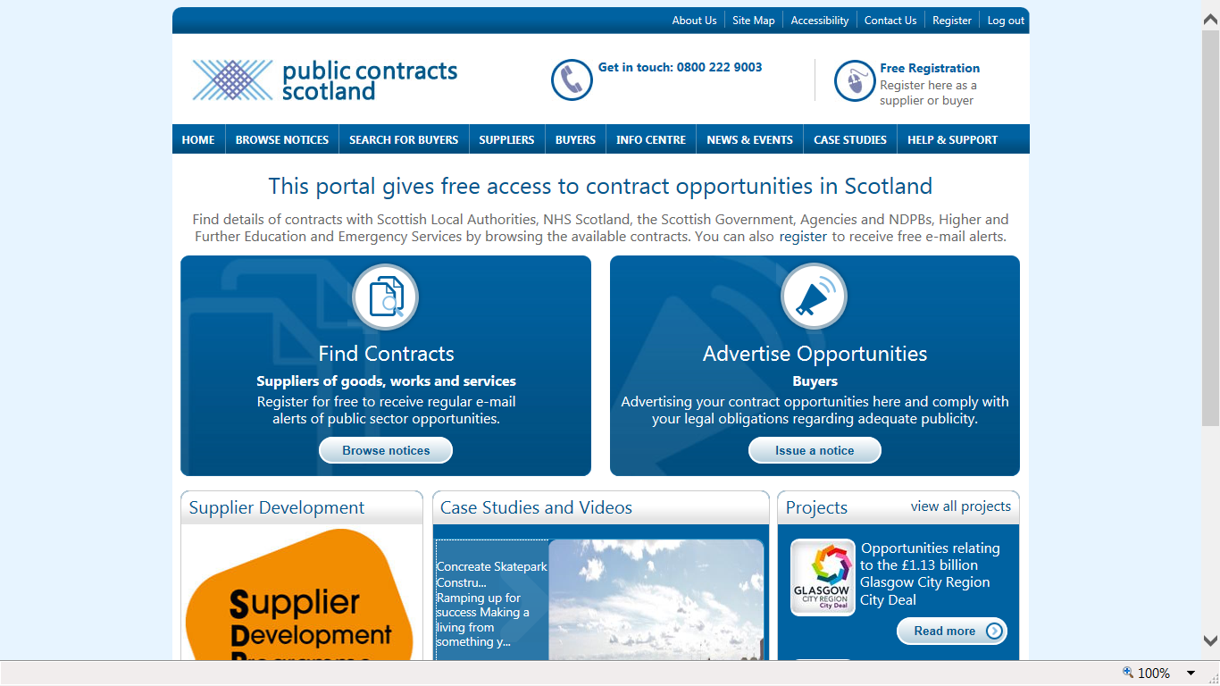
Advertising our Opportunities
PCS Advertising Portal Home Page (PCS-A)

Slide 8
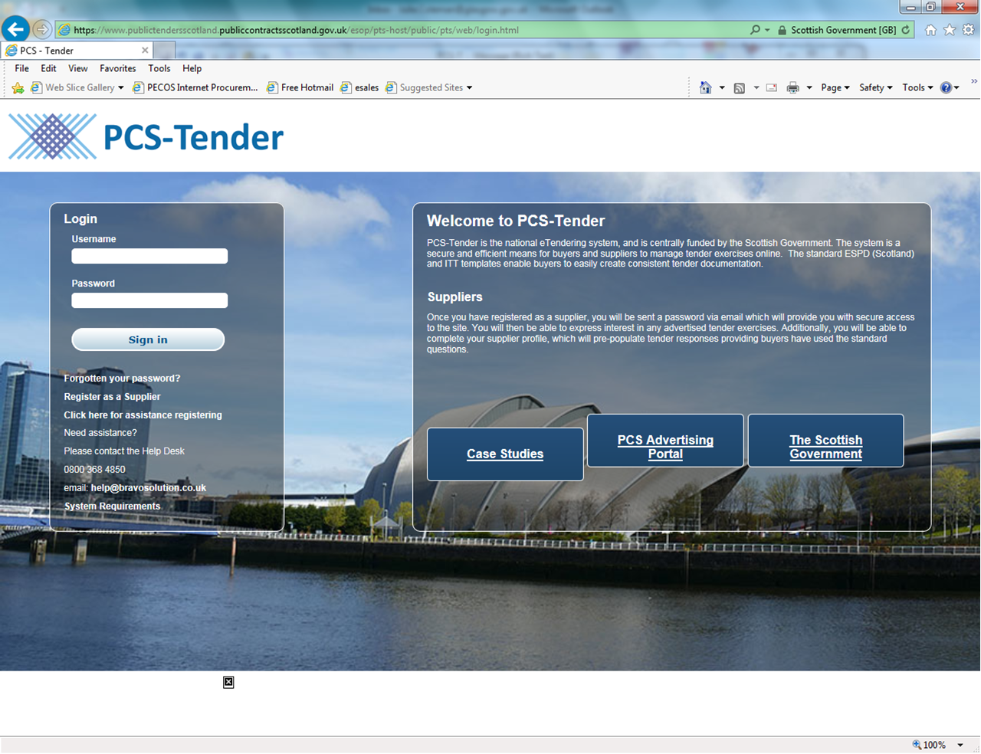
Advertising our Opportunities
PCS Tendering Portal Home Page - (PCS-T)

Slide 9
Procurement Thresholds
Contract opportunities of up to £50k will be published as a Quick Quote via PCS – A
Contract opportunities of between £50k - £163k will be advertised under PCS-A (National) but published via Public Contracts Scotland
Contract opportunities over £163k will be advertised on PCS-A (OJEU) and published on PCS-T

Slide 10
Commodity Classification
Glasgow 2018 European Championships has its own Commodity Classification on PCS-A
When registering or updating your business profile, selecting this classification will ensure you receive free email alerts when G2018 publish opportunities.
Whenever relevant, other commodity classifications will be used to help appropriately categorise the type of good or service being procured.

Slide 11
Our Requirements
Glasgow 2018 have already advertised a number of requirements including Accommodation Management Services, Legal Services, Timing, Scoring and Results and Ticketing. This activity is set to increase with the majority of contracts likely to be awarded throughout 2017 and 2018.
It is expected that a variety of opportunities for goods and services will exist at a range of values. Whilst not exclusive or exhaustive, Glasgow 2018s requirements are likely to include ;
  Technology
  Power
  Marketing and Creative Design
  Event Services
  Overlay Infrastructure and
  Ground Transport
Further details of our requirement and procurement timetable will be added as our planning evolves.

Slide 12
Tendering and Evaluation Process
Glasgow 2018 operates a fair and transparent procurement process which awards contracts on the basis of best overall value.
An explanation of how we measure value is included in every tender, covering the information which we require potential suppliers to complete, and scoring across a range of quality and cost factors to determine the winning bid.
We know that completing tenders takes time and effort, and we try to make our tendering process as simple and straightforward as we can

Slide 13
Tendering and Evaluation Process -Community Benefits
Wherever possible, Glasgow 2018 will seek to achieve community benefits through its tendering activities. All our tenders will therefore include an element of Community Benefits within the award criteria.
Whilst the inclusion of community benefits in each tender will differ depending on the duration, complexity and value of the good or service – the tender documents will outline the requirements as they relate to that specific opportunity
For illustration, the ways in which this could be included are; Mandatory (ie Sub contract advertising), Scored – Work Exp, Mod App or School visit and Non Scored – Voluntary

Slide 14
Tendering and Evaluation Process
Fair Work Practices
All tenders will also have a focus on fair work practices. This question will be worth 5% of the overall tender award criteria
The mains areas it will focus on include;
  Glasgow Living Wage
  Flexible working
  How the company treats its staff.

Slide 15
Tendering and Evaluation Process
Sponsorship and Value in Kind
Glasgow 2018 also has an active sponsorship programme and where appropriate, certain procurement exercises may also enable potential suppliers to offer sponsorship as part of their overall proposal.
The inclusion of sponsorship/value in kind in a procurement activity will be dependent on a range of factors including the commodity and value of the opportunity, and if appropriate may therefore form part of the overall tender evaluation and award criteria.
For further information, please contact the sponsorship team: Richard.ames@europeanchampionships.com

Slide 16
Questions ?
If you have any questions then I am more than happy to discuss these with you after the presentations have finished.
Should you have any questions at a later date regarding procurement opportunities at Glasgow 2018 please contact CorporateProcurement@glasgow.gov.uk
Thanks, Gary Stewart - Operational Procurement Manager

Slide 17
Gillian Cameron
Programme Manager

Slide 18

Glasgow 2018 European Championships

Slide 19



Welcome to the
Supplier Development Programme
SDP is a local authority initiative in partnership with Scottish Government and Digital Scotland Business Excellence Partnership (DSBEP).
The aim of the programme is to ensure that Scottish SMe’s and Third Sector organisations have access to free procurement advice and training, to ensure they can FIND, WIN and KEEP government contracts
Notes:
To ensure they can find win and keep public and private sector contracts

Slide 20
Supplier Development Programme
Who we are
Launched in 2009
32 Scottish local authorities, the Third Sector & Supported Businesses
National Team based at South Lanarkshire Council
Over 8,950 registered business throughout Scotland

Slide 21
Supplier Development Programme
By assisting local businesses to become tender ready for working in the public sector and subsequent supply chain , we improve all-round efficiency, sustainability and market potential.
SDP ensure businesses gain the skill set to tender successfully for contracts and improve their prospects when competing for government contracts, in the UK and beyond.
£10 billion Scottish Government
£240 billion UK
annual spend

Slide 22
Service Offerings
Online Resources www.sdpscotland.co.uk
  Online learning materials
  Procurement jargon buster
  Contacts for your region
  Supplier Register
  Links with Public Contracts Scotland and other
  Business support groups

Slide 23
Service Offerings
Training Programmes
  Regional face to face workshops offered over 3 levels
  Industry specific workshops
  Policy Workshops
  Interactive Webinars
Meet the Buyer
  Information days
  Partner and Business Support events
  Access to local buyers and economic development staff

Slide 24
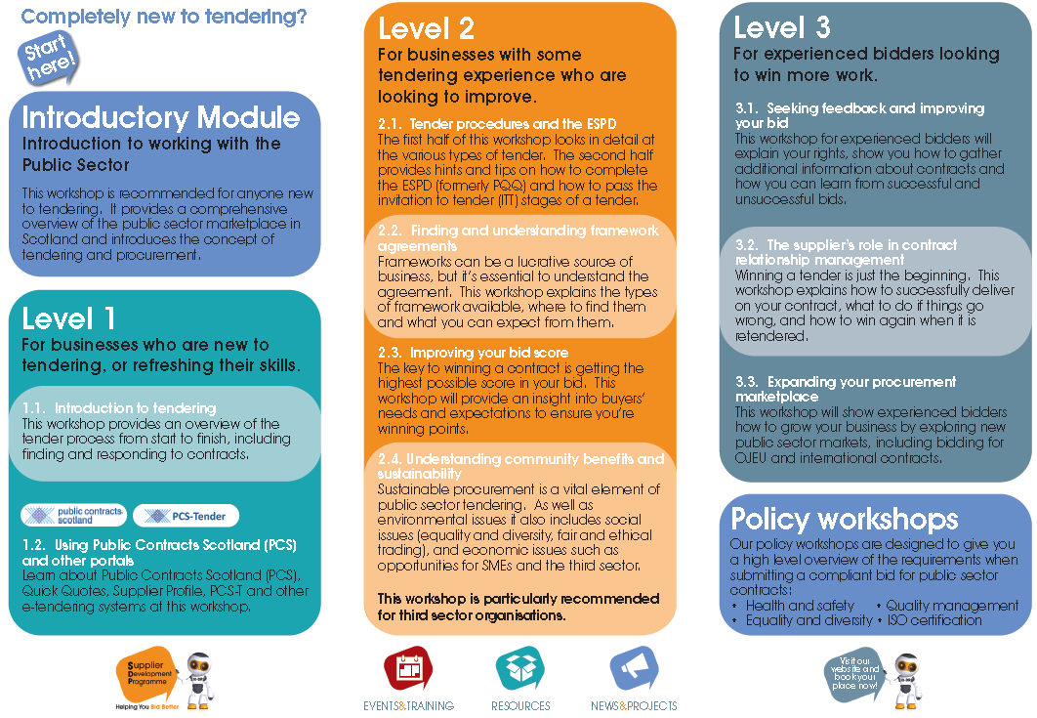
Notes:
Here you can see the range of training we have on offer. Workshops are run across 4 levels; Introductory; beginner and advanced. They cover a range of topics related to tendering for public sector contracts, from the basics of procurement to how to get the best possible score in your bid. No matter what your level of experience, we have an event for you!

Slide 25
Supplier Development Programme
New Directives – New Bidding
New procedures
New timelines
Watch out for Prior Information Notices (PIN) !
Scotland Reform Act Thresholds
£50,000: goods services, and £2 million for works
Contracts Registers online
Procurement Strategy
Get Tender Ready Now!
Notes:
The Public (Scotland ) Regulations 2015 and the Procurement Reform (Scotland) 2014 came into effect on 18th April, offering greater opportunities for SMes to participate in the tender process. It will also offer greater transparency with Public bodies with spend over £5M publishing their procurement strategy and a contract register. The Scotland Reform Act means that public bodies have to publish all service and supply contracts above £50K and Works contracts over £2M on PCS - Make sure you keep up to date with these and many other changes by registering with SDP and attending our training workshops.

Slide 26
European Single Procurement Document (ESPD)
Replaced SPQQ From 18th April 2016
All Scottish Bodies must issue and accept
Allows suppliers to Self- Declare they meet the relevant selection and exclusion criteria
Replaces requirement to provide up front evidence or certificates
More information on the SDP website
https://www.sdpscotland.co.uk/wp-content/uploads/2016/03/ESPD-Supplier-Communication-23-March-2016.pdf

Slide 27
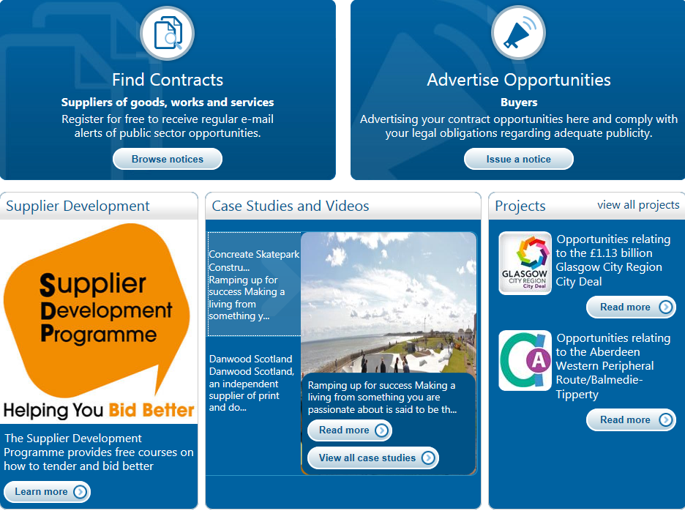

Glasgow 2018 European Championships
Sign up to Public Contracts Scotland www.publiccontractsscotland.gov.uk
  Sign up for the contract alerts
  Add the code 680 for Glasgow 2018 European Championships
  Complete your supplier profile and set to Public.
Check the Projects area on the home page for Glasgow 2018 European Championship opportunities
Notes:
Tenders will be issued from summer 2016 onwards with the highest volume anticipated in 2017

Slide 28
Hints & Tips
Read and re read the Questions!
Use SDP’s helpful Procurement Guide
to help you consider your Bid Strategy
  New or renewal contract
  Approach to Quality –meeting the Specification
  Pricing Strategy
Prepare a database of the basic
information likely to be requested
Clarify- do not presume that the
documentation is correct - ask
questions if you have any concerns
Notes:
Hints & Tips

Slide 29
Common Mistakes
Check List
      Have sufficient capacity
      (small company – big contract)
      Demonstrate financial stability
      Showcase experience of
      similar work successfully
      delivered
      Understand the questions
      Return the required certificates
      Sign and return the necessary
      documentation
Notes:
Common Mistakes that other have made...

Slide 30
Get Ready for Glasgow 2018 European Championships
Register with the Supplier Development Programme www.sdpscotland.co.uk
  Access the Events and Training programme calendar
  Keep up to date with Events and opportunities via the newsletter
  View the Glasgow 2018 European Championships information page
  Follow us on Twitter @sdpscotland
  Complete your entry on the Supplier Register.
Check all your insurance and policies are up to date
  Health & Safety, Equality & Diversity ,
  Quality Management and Environmental
Notes:
Glasgow City Region City Deal – is the first City Deal in Scotland and there are others in the pipeline – Aberdeen, Edinburgh

Slide 31


Meet the Buyer 2017
Why attend?
-Over 50 Public sector bodies
-Supply chain Zone
-Network with both Public and Private sector buyers
-Find opportunities to grow your business

Slide 32

Supplier Development Programme
Gillian Cameron
Programme Manager
www.sdpscotland.co.uk
01698 453734

